Slide 1
Multimedia Systems Lecture – 14
By
Dr. Priyambada Subudhi
Assistant Professor
IIIT Sri City

Slide 2
CCIR and ITU-R Standards for Digital Video
The CCIR is the Consultative Committee for International Radio. One of the most important standards it has produced is CCIR-601 for component digital video.
This standard has since become standard ITU-R Rec. 601, an international standard for professional video applications.
It is adopted by several digital video formats, including the popular DV video.
The NTSC version has 525 scan lines, each having 858 pixels. Because the NTSC version uses 4:2:2, each pixel can be represented with two bytes (8 bits for Y and 8 bits alternating between U and V). The Rec. 601 (NTSC) data rate is thus approximately 216Mbps.

Slide 3
The CIF format (Common Interchange Format) was established for a progressive digital broadcast television. It consists of VHS quality resolutions whose width and height are divisible by 8—a requirement for digital encoding algorithms.
The Quarter Common Interchange Format (QCIF) was established for digital videoconferencing over ISDN lines.
CIF is a compromise between NTSC and PAL, in that it adopts the NTSC frame rate and half the number of active lines in PAL.
When played on existing TV sets, NTSC TV will first need to convert the number of lines, whereas PAL TV will require frame rate conversion.

Slide 4
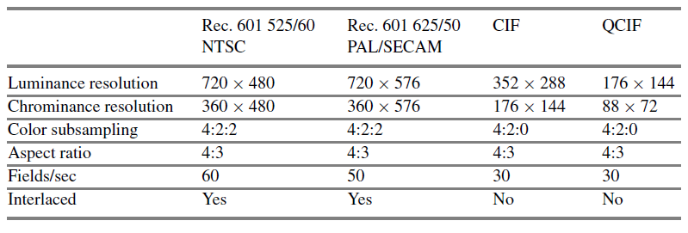
ITU-R digital video specifications

Slide 5
High-Definition TV (HDTV)
The usual NTSC analog TV signal in the United States has 525 scan lines, with 480 actually visible. The usual TV has an effective picture resolution of about 210,000 pixels.
Today, consumers are accustomed to better resolutions such as 1024×768 and even higher, which are now commonly supported by most graphics hardware that come with computers.
A class of digital television called HDTV supports a higher resolution display format along with surround sound.
The visual formats used in HDTV are as follows:
720p—1280×720 pixels progressive
1080i—1920×1080 pixels interlaced
1080p—1920×1080 pixels progressive

Slide 6
They use the MPEG2-based video compression format with a 17 Mbps bandwidth.
Although HDTV signals can be stored and transmitted effectively using MPEG-2 technology, a lot of bandwidth is required to transmit numerous channels.
The aspect ratio of HDTV is 16:9 (1.78:1), which is closer to the ratios used in theatrical movies, typically 1.85:1 or 2.35:1.
The increased resolution provides for a clearer, more detailed picture. In addition, progressive scan and higher frame rates result in a picture with less flicker and better rendering of fast motion.

Slide 7
Ultra High Definition TV (UHDTV)
UHDTV is a new development—a new generation of HDTV.
The standards announced in 2012 support 4K UHDTV: 2160P (3,840×2,160, progressive scan) and 8K UHDTV: 4320P (7,680 × 4,320, progressive scan).
The aspect ratio is 16:9. The bit-depth can be up to 12 bits, and the chroma subsampling can be 4:2:0 or 4:2:2.
The supported frame rate has been gradually increased to 120 fps.
The UHDTV will provide superior picture quality, comparable to IMAX movies, but it will require a much higher bandwidth and/or bitrate.

Slide 8
Digital Display Interfaces
Given the rise of digital video processing and the monitors that directly accept digital video signals, there is a great demand toward video display interfaces that transmit digital video signals.
The most widely used digital video interfaces include
Digital Visual Interface (DVI)
High- Definition Multimedia Interface (HDMI), and
DisplayPort

Slide 9
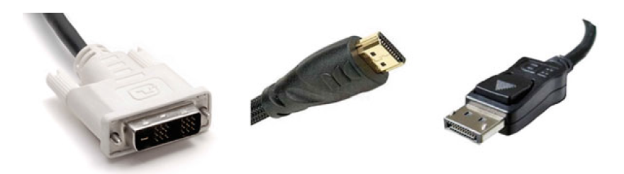
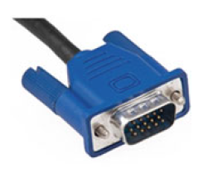
Connectors of different digital display interfaces. From left to right: VGA, DVI, HDMI, DisplayPort

Slide 10
Digital Visual Interface (DVI)
Digital Visual Interface (DVI) was developed by the Digital Display Working Group (DDWG) for transferring digital video signals, particularly from a computer’s video card to a monitor.
It carries uncompressed digital video and can be configured to support multiple modes, including DVI-D (digital only), DVI-A (analog only), or DVI-I (digital and analog).
The support for analog connections makes DVI backward compatible with VGA (Video Graphics Array).

Slide 11
DVI’s digital video transmission format is based on PanelLink, a high-speed serial link technology using transition minimized differential signaling (TMDS).
Through DVI, a source, e.g., video card, can read the display’s extended display identification data (EDID), which contains the display’s identification, color characteristics, and table of supported video modes.
When a source and a display are connected, the source first queries the display’s capabilities by reading the monitor’s EDID block.
A preferred mode or native resolution can then be chosen.
In a single-link mode, the maximum pixel clock frequency of DVI is 165MHz, which supports a maximum resolution of 2.75megapixels at the 60Hz refresh rate.
This allows a maximum 16:9 screen resolution of 1,920×1,080 at 60 Hz.

Slide 12
High-Definition Multimedia Interface (HDMI)
HDMI is a newer digital audio/video interface developed to be backward-compatible with DVI.
Its electrical specifications, in terms of TMDS and VESA/DDC links, are identical to those of DVI.
HDMI, however, differs from DVI in the following aspects:
HDMI does not carry analog signal and hence is not compatible with VGA.
DVI is limited to the RGB color range (0–255). HDMI supports both RGB and YUV 4:4:4 or 4:2:2. The latter are more common in application fields other than computer graphics.
HDMI supports digital audio, in addition to digital video.
The maximum pixel clock rate for HDMI 1.0 is 165MHz, HDMI 1.3 increases that to 340MHz while the latest HDMI 2.0 supports 4K resolution at 60 fps.

Slide 13
DisplayPort
DisplayPort is the first display interface that uses packetized data transmission, like the Internet or Ethernet.
Specifically, it is based on small data packets known as micro packets, which can embed the clock signal within the data stream.
DisplayPort can achieve a higher resolution yet with fewer pins than the previous technologies.
The use of data packets also allows DisplayPort to be extensible.
DisplayPort can be used to transmit audio and video simultaneously, or either of them.
It has a much higher video bandwidth, enough for four simultaneous 1080P 60Hz displays, or 4K video at 60 Hz.

Slide 14
Compared with HDMI, DisplayPort has slightly more bandwidth, which also accommodates multiple streams of audio and video to separate devices.
It is royalty-free, while HDMI charges an annual fee to manufacturers. These points make DisplayPort a strong competitor to HDMI in the consumer electronics market

